Slide 1
Daily Scrum
08/01
Han Sang Lee Java A-4 SK Didimdol 4th hillofsky@naver.com

Slide 2
Task List
Assigned Task | Progress
Data Modeling: Class Diagram | 0%->20%
Database Design | 0%

Slide 3
Yesterday’s Task
Today’s Task
Technical Issue

Slide 4
1. Yesterday’s Task
What I did?
클래스 다이어그램 작성
Trello 및 Dropbox 프로젝트 폴더 구조화

Slide 5
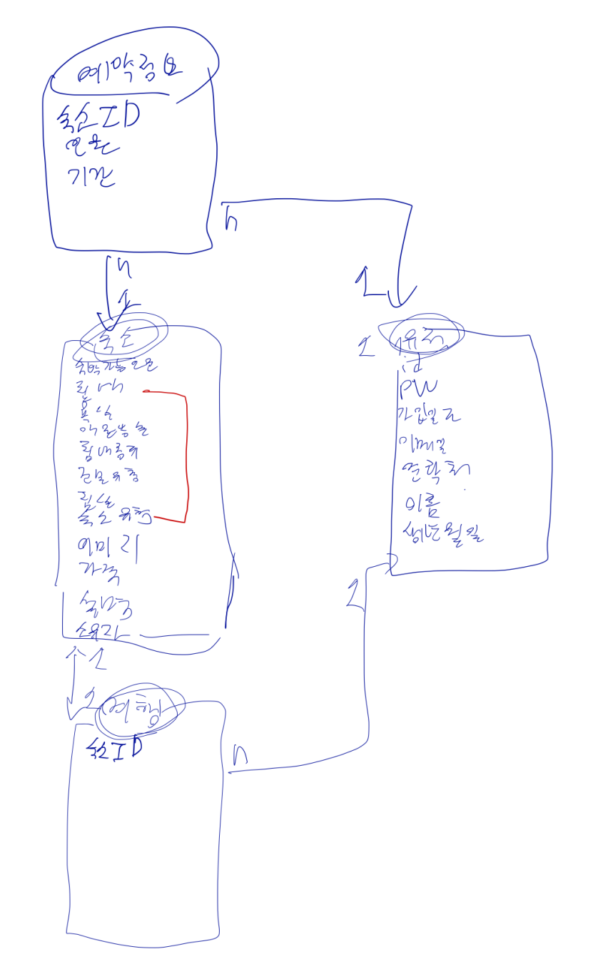
1. Yesterday’s Task
How I did?
클래스 다이어그램 작성
Enterprise Architect 사용
07/26까지의 Design Layout 반영
Trello 및 Dropbox 프로젝트 폴더 구조화
이전에 진행했던 프로젝트 참조

Slide 6
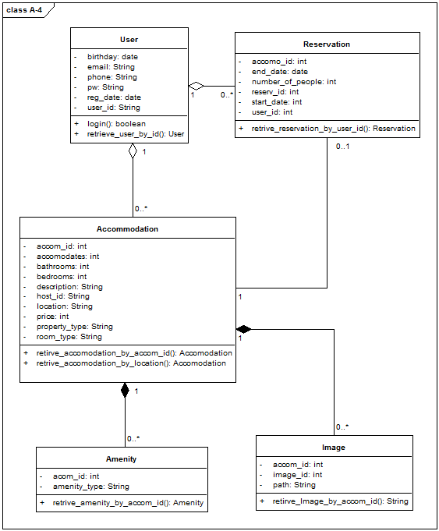
1. Yesterday’s Task
Result

Slide 7
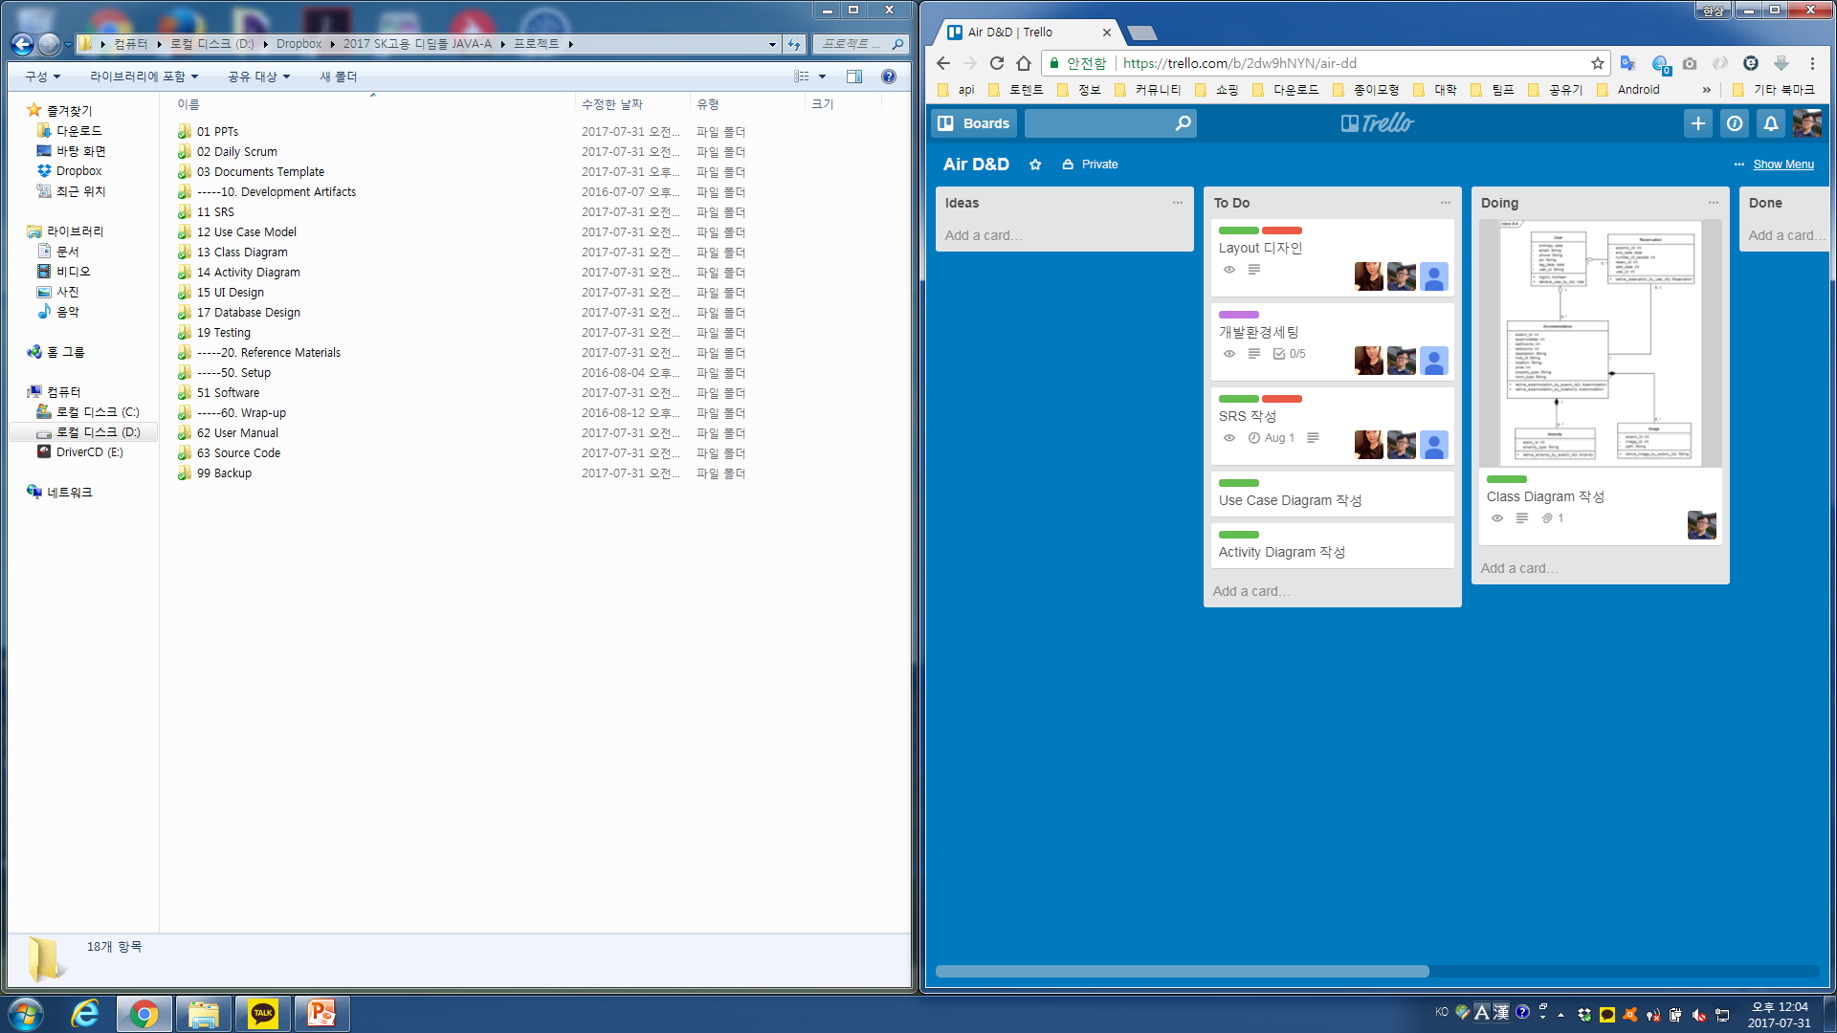
1. Yesterday’s Task
Result

Slide 8
Yesterday’s Task
Today’s Task
Technical Issue

Slide 9
2. Today’s Task
ToDo
SRS 작성
Use Case Diagram 작성
Layout Design
개발환경세팅

Slide 10
Yesterday’s Task
Today’s Task
Technical Issue

Slide 11
3. Technical Issue
Issue
(None)

Slide 12
END

